Slide 1
Lock Guardian
Krzysztof Uszko Hubert Rydz Maciej Kasprzyk

Slide 2
PROBLEM
Solution that will let company secure any of their assets…

Slide 3
EXISTING SOLUTIONS
Encryption
Endpoint Monitoring
SOC
Next-Gen Firewall

Slide 4















EXISTING SOLUTIONS
Encryption
Endpoint Monitoring
SOC
Next-Gen Firewall

Slide 5
“Sounds good… However”

Slide 6
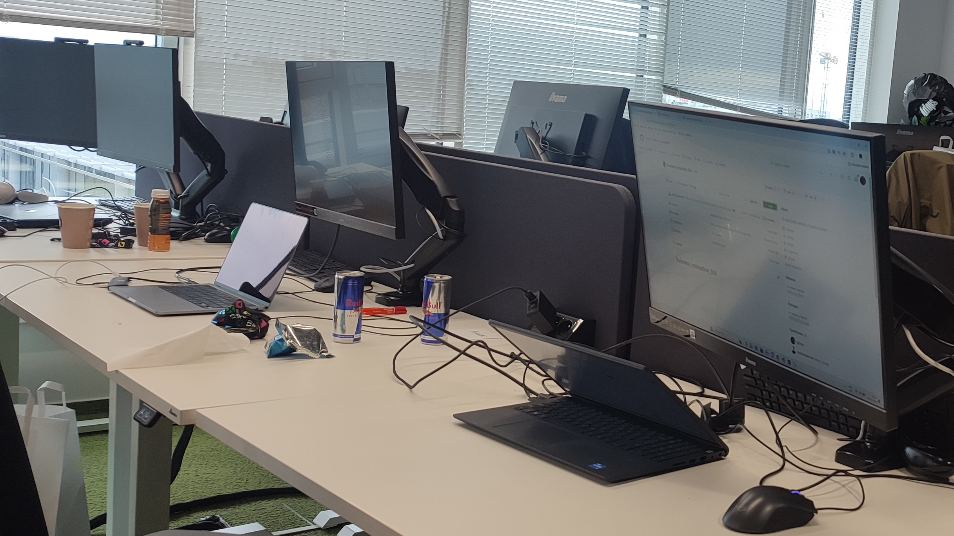
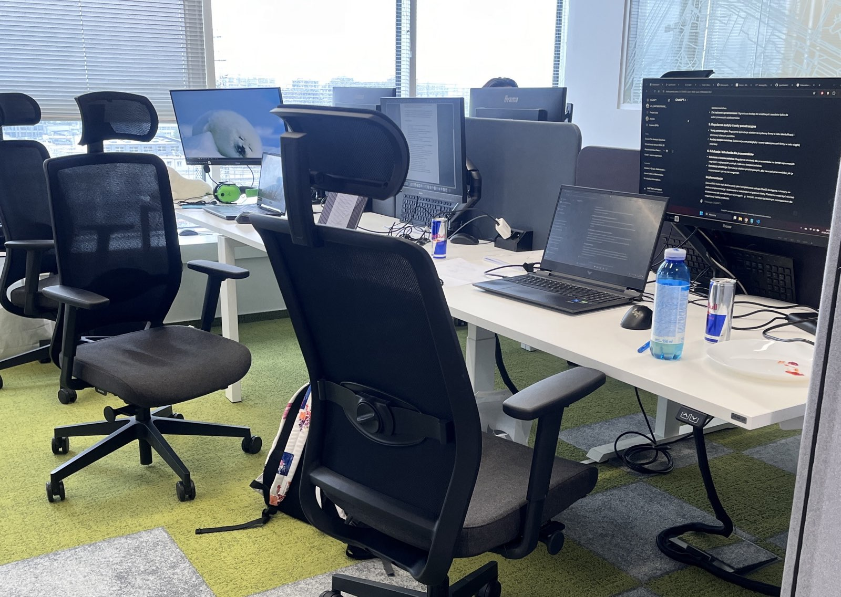
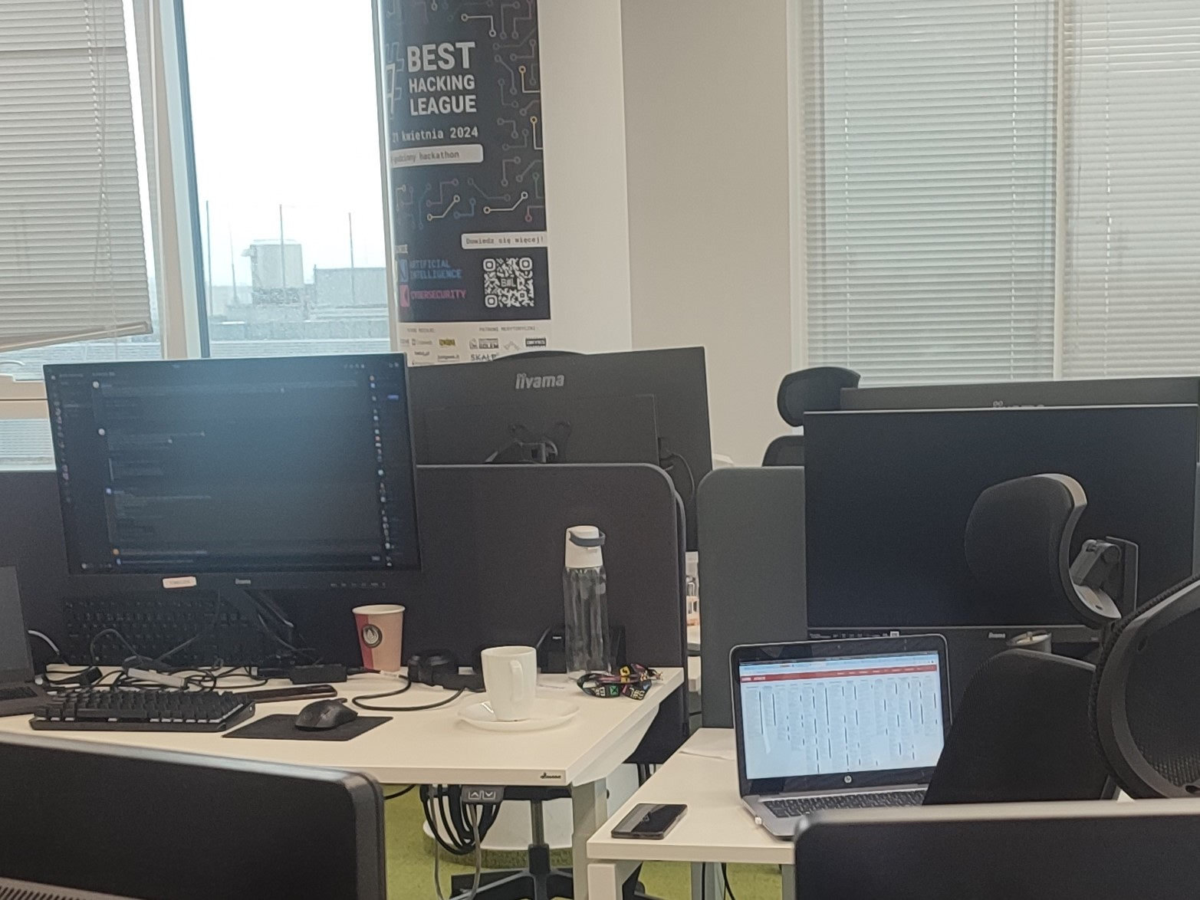
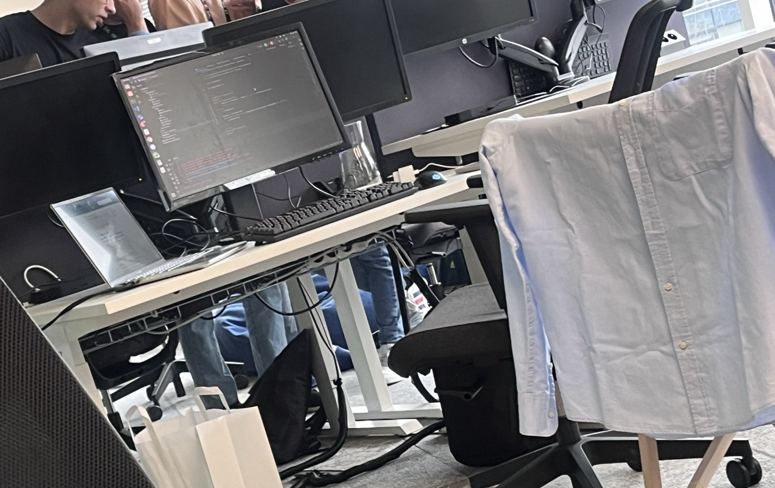

Slide 7
SOLUTION
What if our solution is feasible to protect the security fundamentials all together? 😎

Slide 8



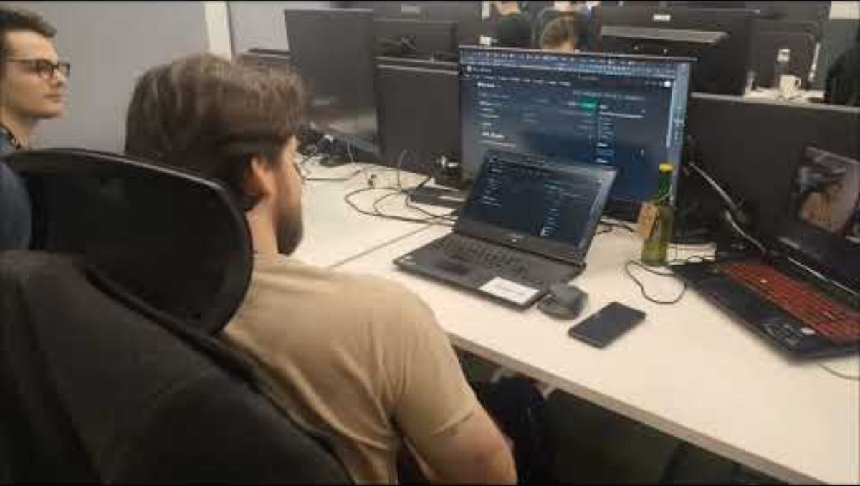


PoC
ResNet-50

Slide 9



IMPLEMENTATION
Assigned workplaces
Existing cameras
Open space offices

Slide 10
THEM
COMPETITIVE ADVANTAGE
US
No such solution on the market.
Easy to implement. Easy to maintain.
Low effort big income.

Slide 11
PRIVACY CONCERNS
According to Polish law, it is possible to monitor workplaces with previous employee’s approval.
Interrupting personal space is prohibited – we do not violate it.
Sources: https://sip.lex.pl/akty-prawne/dzu-dziennik-ustaw/kodeks-pracy-16789274/art-22-2 https://dlafirm.pracuj.pl/blog/monitoring-w-miejscu-pracy

Slide 12
FINANCE & INFRASTRUCTURE
It is way cheaper than investing a lot in mandatory training.
Possibility of building on top of an existing monitoring system.

Slide 13



PRODUCT OVERVIEW
Screen locking
Data Gathering & Statistics
Adversary detection
Jokes

Slide 14

FUTURE PLANS
Data driven reports
Advanced reporting of employee’s security breaches.
Badges detection
Detecting unprivileged office access.
Security empowerment
Engaging users into security awareness through gamification.

Slide 15
THANKS
Do you have any questions?

